Slide 1

By
Tushar Sharma
Jiahuan Li
Rasagnya Reddy Avala
Shreegowri Mattighatta Bhojanna
DATA VISUALIZATION HACKATHON

Slide 2
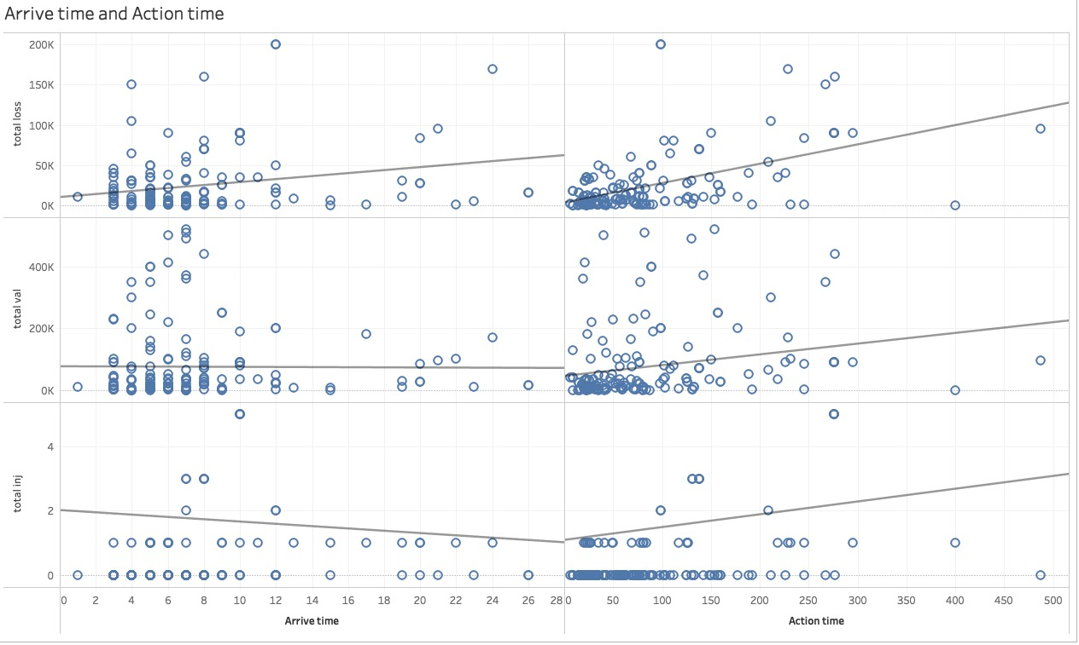
Feature Selection

Slide 3
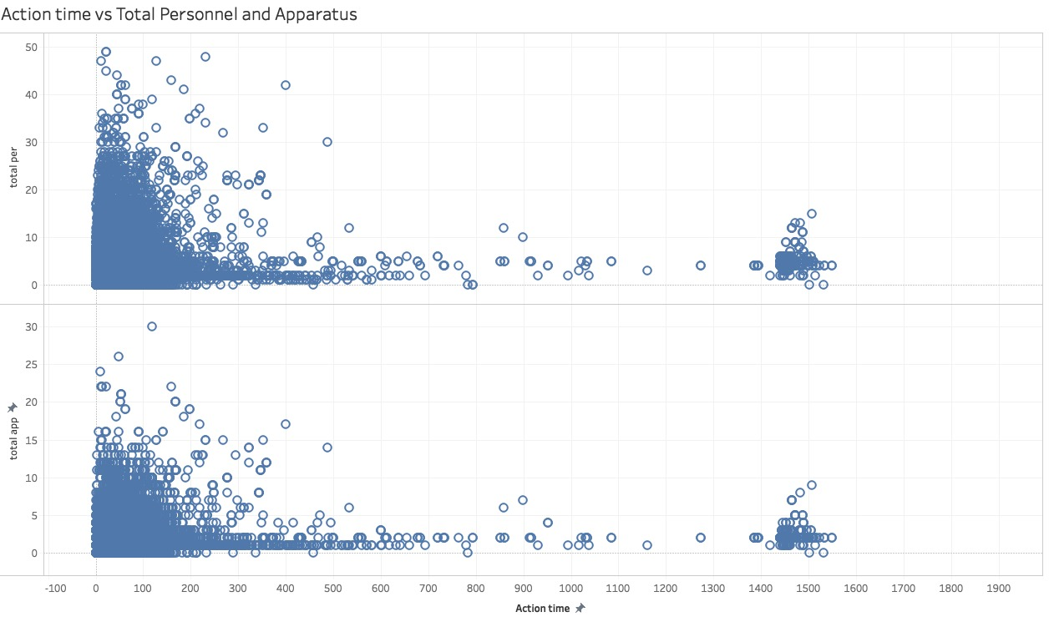
Emphasis on Personnel and Equipment

Slide 4
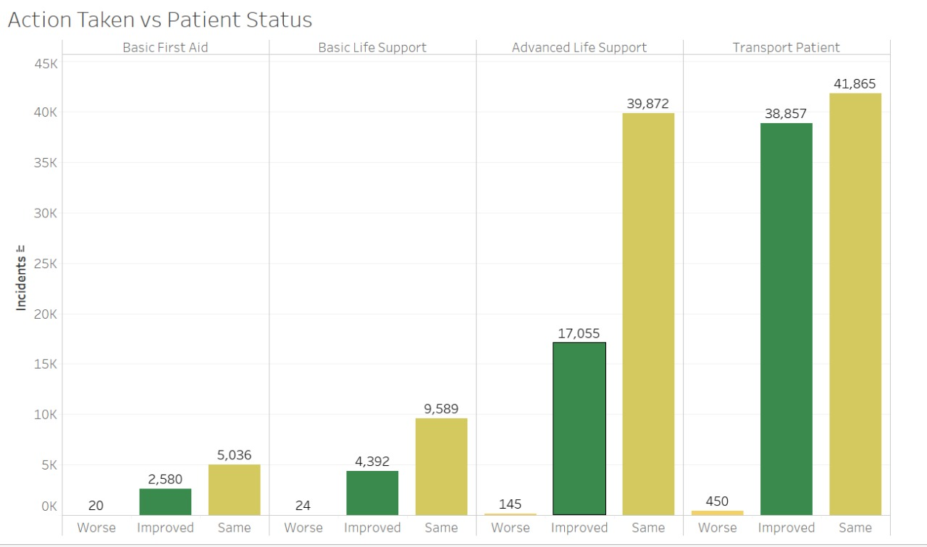

Slide 5
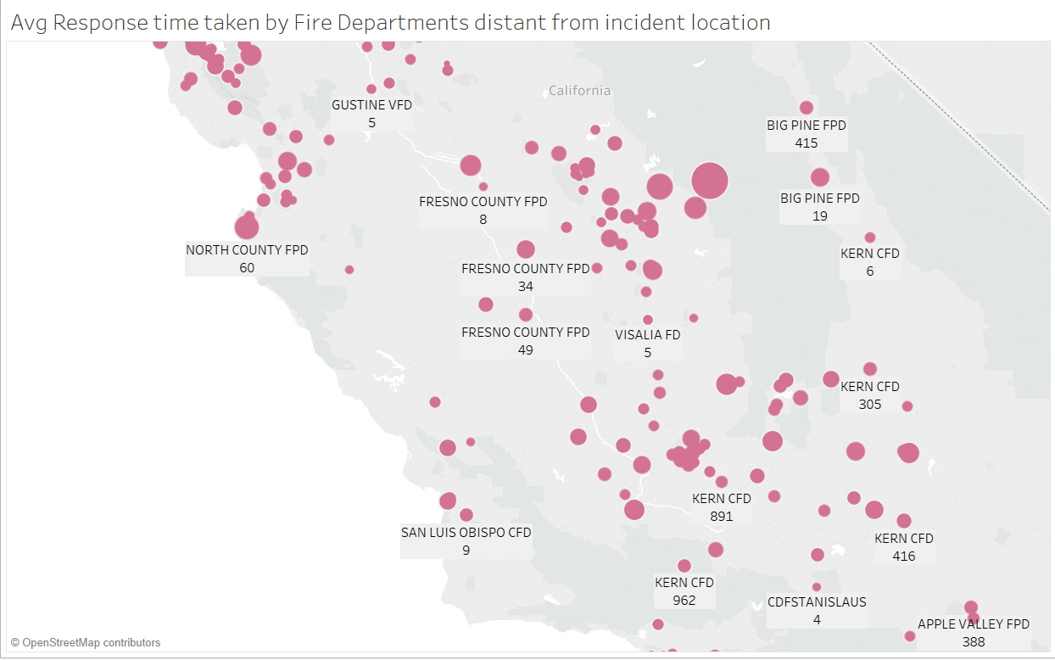

Slide 6
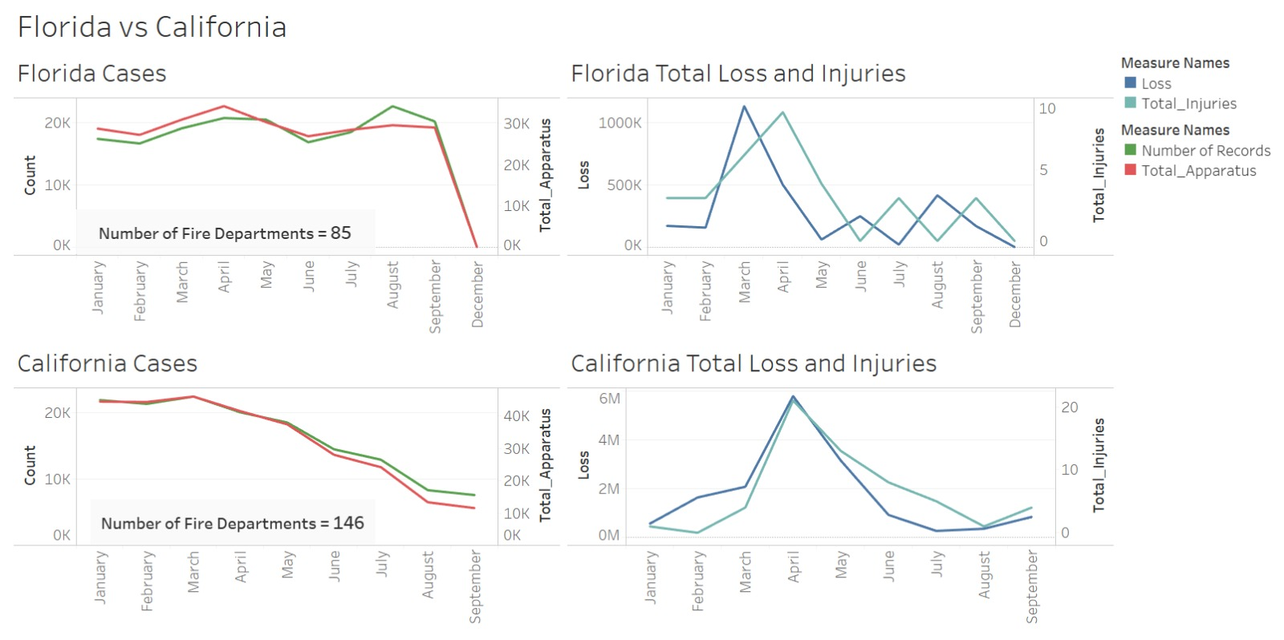

Slide 7
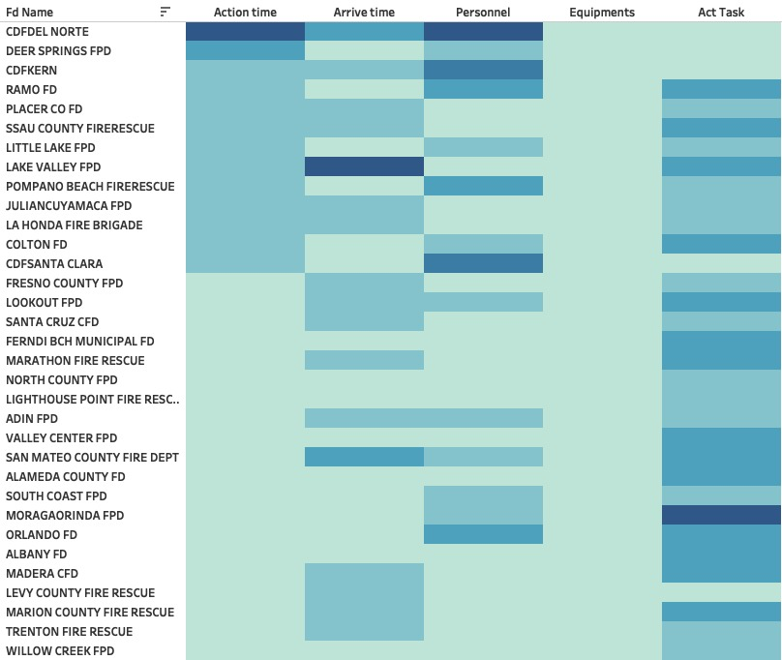
HeatMap of Performance Metrics by Fire Departments

